Slide 1

Property BASED Generator TESTING
Justice Martinez

Slide 2

What is property based generator testing?
Functional languages, such as Haskell, needed ways to testing their programs
With out being able to run multiple tests, there could be bugs
A function may run for specific inputs, ones that users need at the moment, but it may not work for all inputs
Tests functions with randomly generated inputs
The Haskell library QuickCheck released in 1999
Since this release over 30 other languages have released similar testing suites
C++, Java, JavaScript, Perl, Prolog, Python, Smalltalk, Rust, Swift, etc.

Slide 3
How does Property testing work?
Uses user-created properties and generators for inputs
This includes the statement to be tested and types of inputs this should be true for
Randomly creates inputs to test correctness of statement
Usually runs about 100 tests that get increasingly more complicated
If it fails at any point, it will break down the failing cases into its simplest form that fails

Slide 4
Examples of Simple Expressions
1) prop_reverse :: [Int] -> Bool
prop_reverse xs = reverse (reverse xs) == xs
2) prop_revapp :: [Int] -> [Int] -> Bool
prop_revapp xs ys = reverse (xs++ys) == reverse xs ++ reverse ys

Slide 5
How Do generators work?
Testing conditional properties creates problems (p ⇒ q)
Generators will skip over anything that does not fit the criteria for p
If the generator is random it is hard to create a good test for conditional properties
Coding generators
Can be complicated using complicated Lambda-Calculus expression
Code can be hard to read

Slide 6
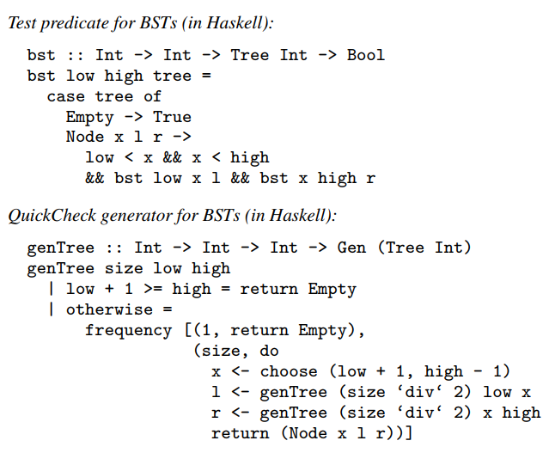

Slide 7
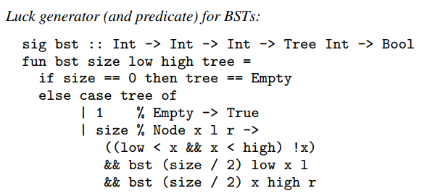
Solutions?
New domain-specific language called Luck
Able to create the needed properties and generators for those properties in the same code
Still in developmental stages

Slide 8
Sources
Chen, Zilin, et al. “The Cogent Case for Property-Based Testing.” Proceedings of the 9th Workshop on Programming Languages and Operating Systems - PLOS17, 2017, doi:10.1145/3144555.3144556.
Lampropoulos, Leonidas, et al. “Beginners luck: a language for property-Based generators.” ACM SIGPLAN Notices, vol. 52, no. 1, Jan. 2017, pp. 114–129., doi:10.1145/3093333.3009868.
Löscher, Andreas, and Konstantinos Sagonas. “Targeted property-Based testing.” Proceedings of the 26th ACM SIGSOFT International Symposium on Software Testing and Analysis - ISSTA 2017, 2017, doi:10.1145/3092703.3092711.
Vasconcelos, Pedro. “An introduction to QuickCheck testing.” School of Haskell | School of Haskell, FPComplete, 24 Apr. 2015, www.schoolofhaskell.com/user/pbv/an-introduction-to-quickcheck-testing.

